Slide 1

Hakk.AI
Microsoft Azure Virtual Hackathon
Singapore Dataset
Endpoint: http://12929100-4b3e-48aa-b7bc-329316a625ee.eastus.azurecontainer.io/score

Slide 2
Example of Using Endpoint
import requests
import json
# URL for the web service
scoring_uri = 'http://12929100-4b3e-48aa-b7bc-329316a625ee.eastus.azurecontainer.io/score’
# Two sets of data to score, so we get two results back
data = {"data":
[
{
"latitude_origin": -6.141255,
"longitude_origin": 106.692710,
"latitude_destination": -6.141150,
"longitude_destination": 106.693154,
"timestamp": 1590487113,
"hour_of_day": 9,
"day_of_week": 1
},
{
"latitude_origin": -6.141255,
"longitude_origin": 106.692710,
"latitude_destination": -6.141150,
"longitude_destination": 106.693154,
"timestamp": 1590487113,
"hour_of_day": 9,
"day_of_week": 1
}
]
}
# Convert to JSON string
input_data = json.dumps(data)
# Set the content type
headers = {'Content-Type': 'application/json'}
# Make the request and display the response
resp = requests.post(scoring_uri, input_data, headers=headers)
print(resp.text)
Endpoint: http://12929100-4b3e-48aa-b7bc-329316a625ee.eastus.azurecontainer.io/score

Slide 3
Table of Content
- Data source
- Data Preprocessing
- Feature Engineering
- Data Cleaning
- Modeling
- Experiments
- Model Deployment
- Azure Architecture
- Mobile Application
- Future work
Hakk.AI
Microsoft Azure Virtual Hackathon

Slide 4
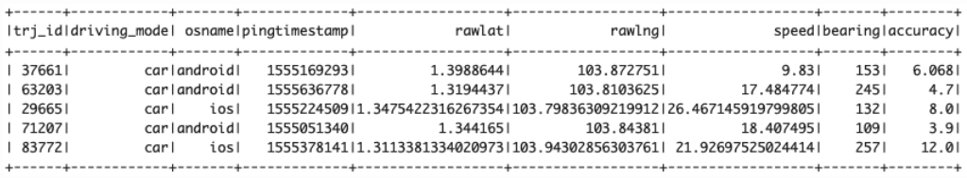
Data source
- In this problem, we are using Grab-posisi (Singapore) dataset
Reference : https://engineering.grab.com/grab-posisi
Hakk.AI
Microsoft Azure Virtual Hackathon

Slide 5
Data preprocessing
Hakk.AI
Microsoft Azure Virtual Hackathon

Slide 6
Data preprocessing
1. For the initial stage, we load the data using PyArrow (https://arrow.apache.org/docs/python/parquet.html)
2. We converted the pingtimestamp into the actual timestamp that consists of YYYY-MM-DD hh:mm:ss
3. We sorted the value by trj_id and pingtimestamp
4. Then, we get the travel time by substracting difference in first pingtimestamp and the last pingtimestamp for each trajectory ID
Hakk.AI
Microsoft Azure Virtual Hackathon

Slide 7
Get travel time (Target)
# get the travel time by substracting difference in first pingtimestamp with the last pingtimestamp for each trajectory ID
data['travel_time'] = data.groupby(['trj_id']).timestamp.transform(lambda x: x.max() - x.min()).astype('timedelta64[s]')
data['pickup_time'] = data.groupby(['trj_id']).timestamp.transform(lambda x: x.min())
data['dropoff_time'] = data.groupby(['trj_id']).timestamp.transform(lambda x: x.max())
Hakk.AI
Microsoft Azure Virtual Hackathon

Slide 8
Data preprocessing
5. We want to get latitude_origin, longitude_origin, latitude_destination and longitude destination
def extractCoordinateAndUpdateDF(df, variable_name, timestamp_col, coordinate_component):
#Create new column containing a coordinate component of geolocation at a certain timestamp
coord_series = df.groupby(['trj_id']).apply(lambda x: x[x['timestamp'] == x[timestamp_col]][coordinate_component])
coord_series = coord_series.reset_index().set_index('level_1')
df_update = df.merge(coord_series, how='left', left_on='trj_id', right_on='trj_id', suffixes=['', '_{}'.format(variable_name)])
return df_update
data= data.rename(columns={'rawlat': 'latitude', 'rawlng': 'longitude'})
# create and merge pickup latitude into data
data = extractCoordinateAndUpdateDF(data, 'origin', 'pickup_time', 'latitude')
# create and merge pickup longitude into data
data = extractCoordinateAndUpdateDF(data, 'origin', 'pickup_time', 'longitude')
# add drop off latitude
data = extractCoordinateAndUpdateDF(data, 'destination', 'dropoff_time', 'latitude')
# add drop off longitude
data = extractCoordinateAndUpdateDF(data, 'destination', 'dropoff_time', 'longitude')
Hakk.AI
Microsoft Azure Virtual Hackathon

Slide 9
Data preprocessing
6. We drop duplicate based on subset of trj_id and travel_time, and keep it the first one.
data = data.drop_duplicates(subset=['trj_id', 'pickup_time'], keep='first')
Hakk.AI
Microsoft Azure Virtual Hackathon

Slide 10
Feature Engineering
Hakk.AI
Microsoft Azure Virtual Hackathon

Slide 11
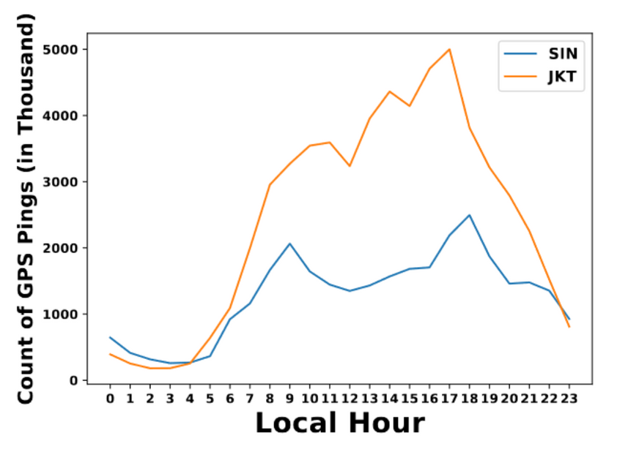
Time-based feature
1. The line chart below shows the count of GPS Ping in local hour. Looking at this, there are some patterns in Singapore's data in timely manner.
Reference: https://engineering.grab.com/files/Grab-Posisi_An_Extensive_Real-Life_GPS_Trajectory_Dataset_in_Southeast_Asia.pdf
Hakk.AI
Microsoft Azure Virtual Hackathon

Slide 12
Time-based feature
2. From 1 AM - 5 AM, the line chart shows that there lacks GPS Ping. It gives the impression that there lacks mobility during that time
Reference: https://engineering.grab.com/files/Grab-Posisi_An_Extensive_Real-Life_GPS_Trajectory_Dataset_in_Southeast_Asia.pdf
Hakk.AI
Microsoft Azure Virtual Hackathon

Slide 13



Time-based feature
2. From 7.30 AM - 9.30 AM and 5 PM - 8 PM, It is usually Singapore's rush hour. In the chart, it shows that there is a sudden increase at 7.30 AM and 4 PM, then, it begins to slow down around 9.30 AM and 8 PM. We made rush_hour features for both morning and evening. We used 5 PM instead of 4 PM due to personal experience in Singapore for the evening rush hour feature.
Reference: https://engineering.grab.com/files/Grab-Posisi_An_Extensive_Real-Life_GPS_Trajectory_Dataset_in_Southeast_Asia.pdf
Hakk.AI
Microsoft Azure Virtual Hackathon

Slide 14
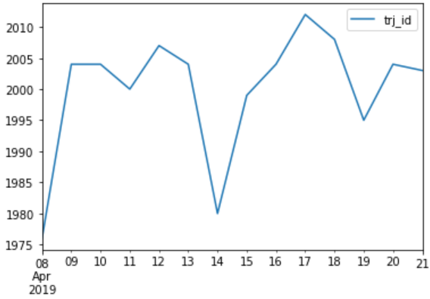
Time-based feature
3. The distribution of rides by day seems to follow the trends that Sunday has less ride and any other day have more people take a ride. This may be caused by work commuting. 2019-04-19 is the exception since its a "Good Friday" and a holiday where people don't go to school or work while 2019-04-21 is easter day. This may be caused of the surge in rides. Unfortunately we only have 2 weeks worth of data, so we can't see clearly the pattern of time sensitive data.
GPS Ping Count
Date
Hakk.AI
Microsoft Azure Virtual Hackathon

Slide 15
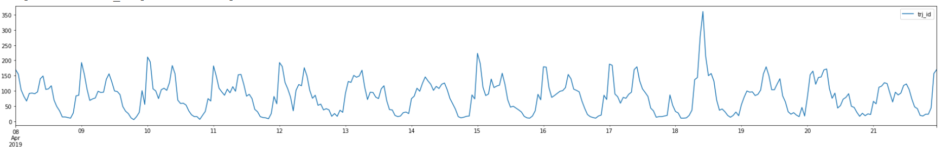
Hour and day to cyclical data
4. The distribution of number of rides in most cases, following a similar pattern daily and weekly (e.g. Working hour will always be the same everyday, and the number of cars commuting to work will most likely be higher than the rest of the day and follow the same pattern throughout the week) In this regard, we could encode the time features to reflect the cyclical nature with trigonometric function.
Figures show the number of trj_id with respect to the hour in a day for every day of the dataset. We can see that it follows a similar pattern in distribution everyday with some exceptions.
Hakk.AI
Microsoft Azure Virtual Hackathon

Slide 16
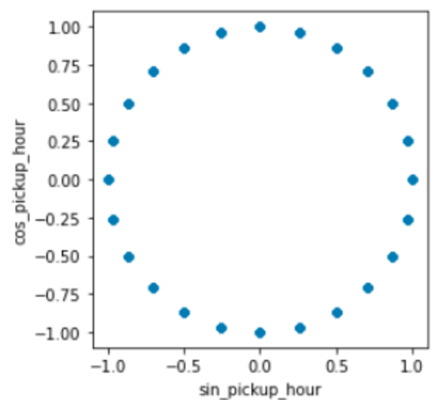
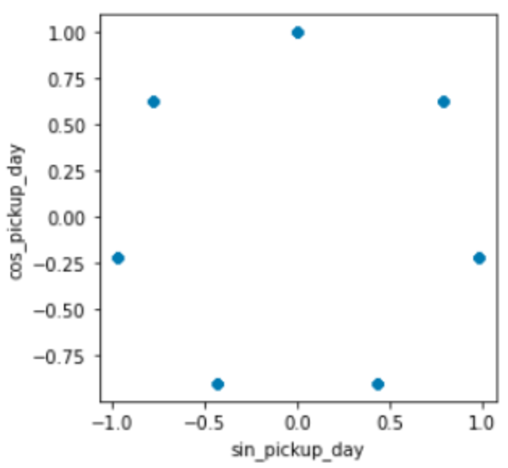
Hour and day to cyclical data
Following are the feature transformation of days in a week and hours in a day:
Sin_hour_of_day: this column is the sin value of the hours of a day. The value will be in the range of -1 to 1.
Cos_hour_of_day: this column corresponds to the cos value of hour of a day.
Sin_day_of_week: a sin value for the day in a week. The domain of this column is an integer from 0 to 6, where each value corresponds to a day in a week.
Cos_day_of_week: this corresponds to the cos value for the day of the week.
The figures show the plot of sin and cos value of day and hour.
Hakk.AI
Microsoft Azure Virtual Hackathon

Slide 17
Location-based feature
Haversine is used to calculate the approximate distance. We both used the km and m as the features.
def haversine_km(lon1, lat1, lon2, lat2):
"""
Calculate the great circle distance between two points
on the earth (specified in decimal degrees)
All args must be of equal length.
"""
lon1, lat1, lon2, lat2 = map(np.radians, [lon1, lat1, lon2, lat2])
dlon = lon2 - lon1
dlat = lat2 - lat1
a = np.sin(dlat/2.0)**2 + np.cos(lat1) * np.cos(lat2) * np.sin(dlon/2.0)**2
c = 2 * np.arcsin(np.sqrt(a))
km = 6367 * c
return km
def haversine_m(lon1, lat1, lon2, lat2):
"""
Calculate the great circle distance between two points
on the earth (specified in decimal degrees)
All args must be of equal length.
"""
lon1, lat1, lon2, lat2 = map(np.radians, [lon1, lat1, lon2, lat2])
dlon = lon2 - lon1
dlat = lat2 - lat1
a = np.sin(dlat/2.0)**2 + np.cos(lat1) * np.cos(lat2) * np.sin(dlon/2.0)**2
c = 2 * np.arcsin(np.sqrt(a))
m = 3956 * c
return m
Hakk.AI
Microsoft Azure Virtual Hackathon

Slide 18
Data Cleaning
Hakk.AI
Microsoft Azure Virtual Hackathon

Slide 19
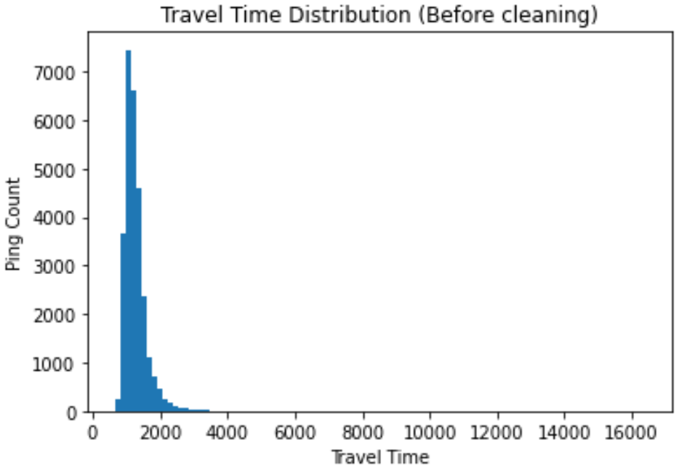
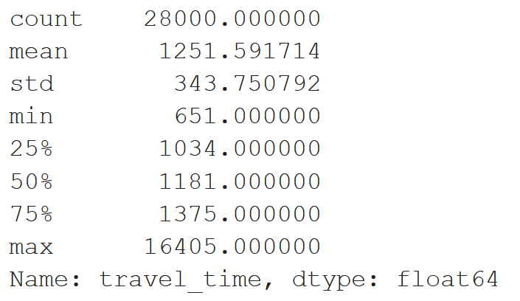
Data Cleaning
1. We found out the distribution of our travel time has outliers. It is evident by the statistics and our histogram below:
Hakk.AI
Microsoft Azure Virtual Hackathon

Slide 20
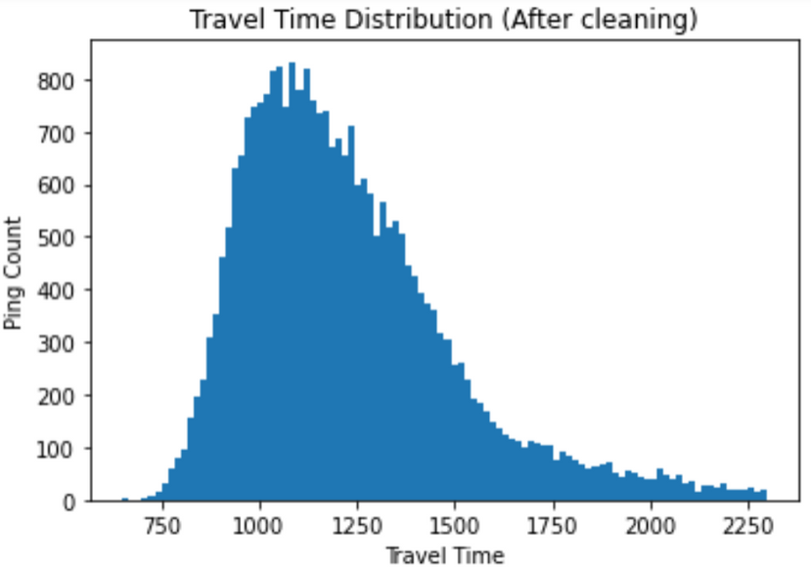
Data Cleaning
2. We approximate that the outliers is when the travel_time >= 2300, so we decided to drop the rows that contain the values. At the end, we have a much better look distribution. Our data now contains 27,542‬ rows instead of 28,000 rows.
Hakk.AI
Microsoft Azure Virtual Hackathon

Slide 21
Modelling
Hakk.AI
Microsoft Azure Virtual Hackathon

Slide 22
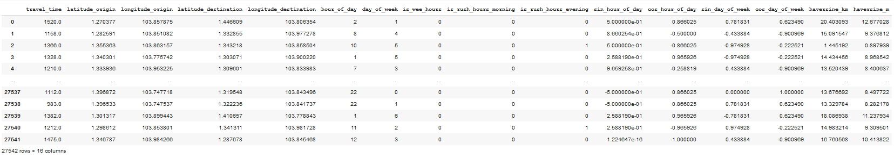
Modelling
These are the data we used to perform modelling. Travel_time will be the y while others will be the X.
Hakk.AI
Microsoft Azure Virtual Hackathon

Slide 23
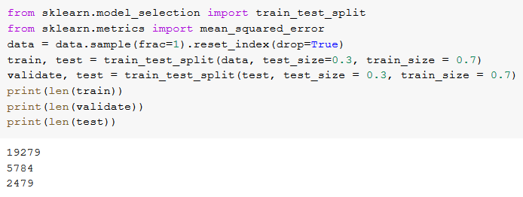
Modelling
The following is how we split our data.
Train: 19279
Validation: 5784
Test: 2479
Hakk.AI
Microsoft Azure Virtual Hackathon

Slide 24
Experiment
Hakk.AI
Microsoft Azure Virtual Hackathon

Slide 25
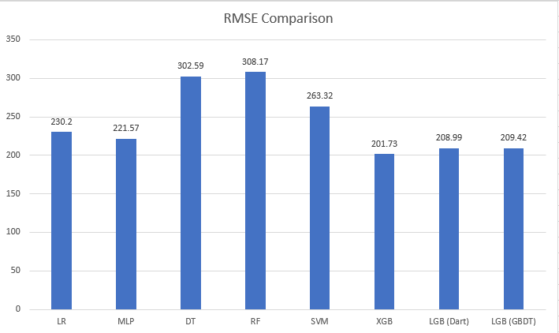

Experiment
Legends:
LR: Linear Regression
MLP: Multi-layer Perceptron
DT: Decision Tree
RF: Random Forest
SVM: Support Vector Machine
XGB: XGBoost
LGB: LightGBM
Based on our experiment, Gradient Boosting has the lowest RMSE among other models
Hakk.AI
Microsoft Azure Virtual Hackathon

Slide 26
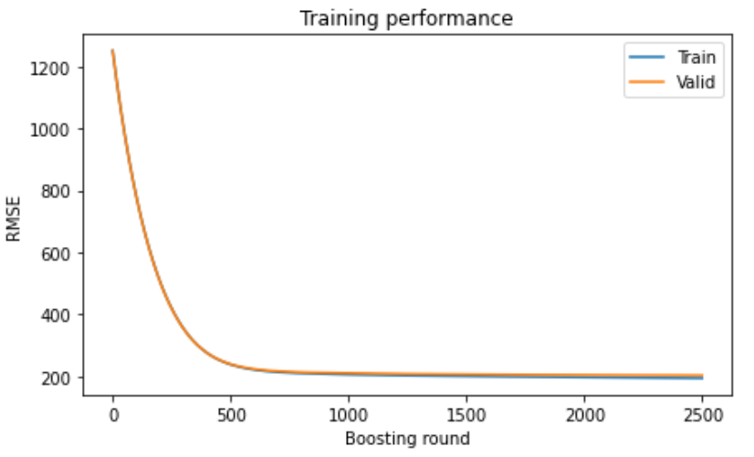
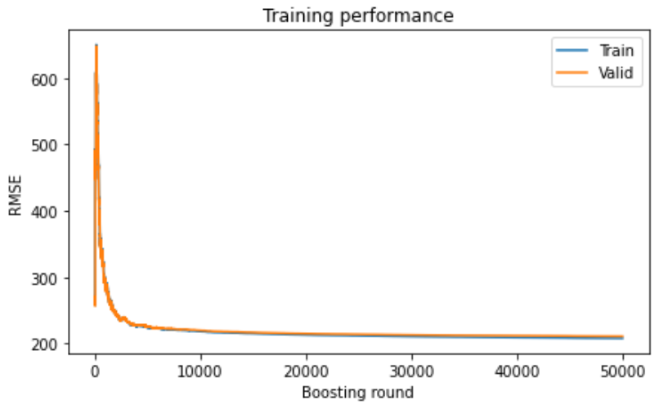
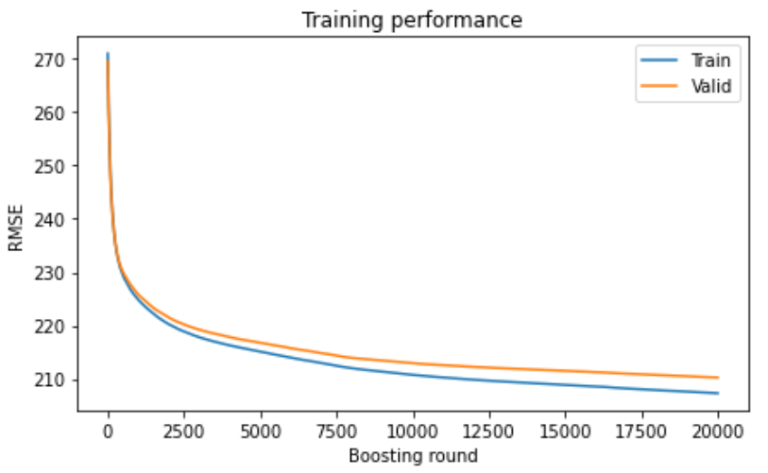
Experiment
XGBoost
LightGBM (DART)
LightGBM (GBDT)
Based on our experiment, the models are not overfitting evident from the learning curve graph. For our endpoint, we are using XGBoost
Hakk.AI
Microsoft Azure Virtual Hackathon

Slide 27
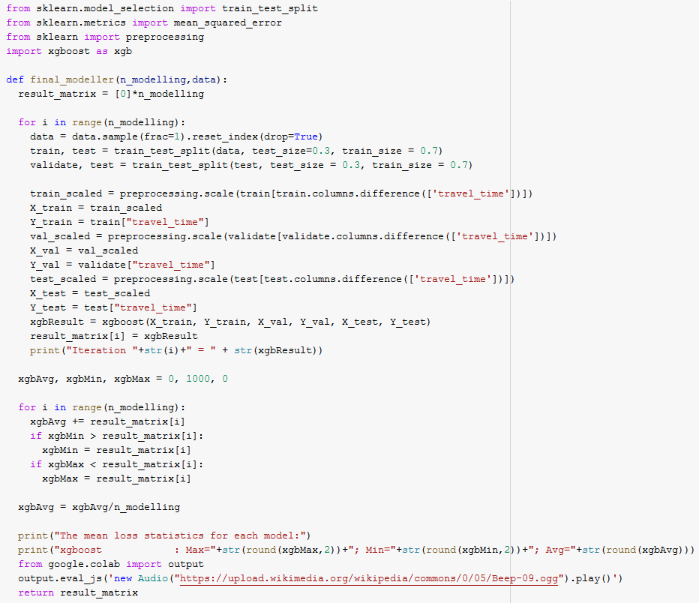
Consistency test
In order to test the consistency of the chosen model, we created a script to call the model to train and predict the test data multiple times. For every testing, we use different splits for train, valid, and test data so that we know that the model performs good regardless of the sample taken. During each iteration, we print the mean loss and combine all of them into the overall statistics which consist of maximum, minimum, and average mean loss
Hakk.AI
Microsoft Azure Virtual Hackathon

Slide 28
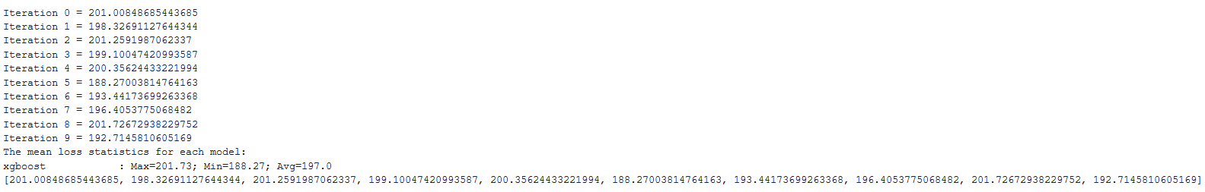
Consistency test
Result of our XGBoost consistency test
Hakk.AI
Microsoft Azure Virtual Hackathon

Slide 29
Model Deployment
Hakk.AI
Microsoft Azure Virtual Hackathon

Slide 30
Model Deployment
The Azure Container Instances (ACI) service is used, in order to deploy the model and run inside the container. Based on the inference, deployment configuration provided, it creates the environment for the container, once the model is registered to the Azure container registry and then deployment takes place for the model which is trained and built using Azure Machine Learning. It then exposes the following REST API endpoint. The entry script is created in a way that receives input data submitted to the model as JSON and response is returned to the client.
Also monitoring the deployed web service, collecting data for analytics is performed using Azure App Insight.
Hakk.AI
Microsoft Azure Virtual Hackathon

Slide 31
http://12929100-4b3e-48aa-b7bc-329316a625ee.eastus.azurecontainer.io/swagger.json
Model Deployment
http://12929100-4b3e-48aa-b7bc-329316a625ee.eastus.azurecontainer.io/score
Swagger
http://12929100-4b3e-48aa-b7bc-329316a625ee.eastus.azurecontainer.io/swagger.json
Hakk.AI
Microsoft Azure Virtual Hackathon

Slide 32
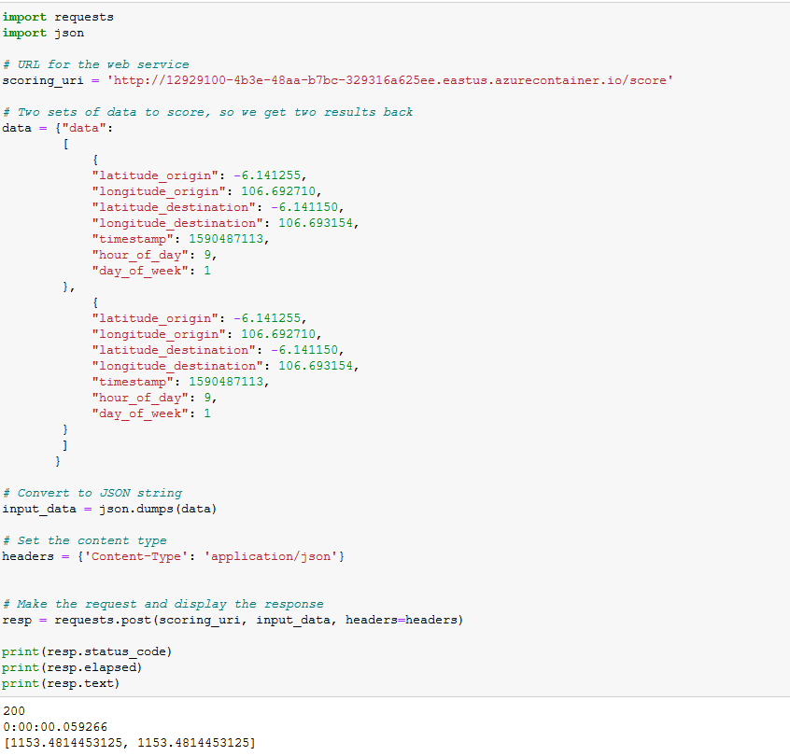
Model Deployment
Our REST API is working.
We tried using 10,000 samples from in our preprocessed dataset.
Our endpoint got around 280 test RMSE
Hakk.AI
Microsoft Azure Virtual Hackathon

Slide 33
Azure Architecture
Hakk.AI
Microsoft Azure Virtual Hackathon

Slide 34






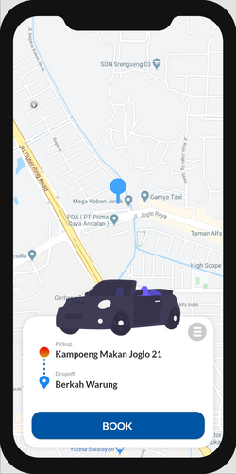
Azure Architecture
Grab-posisi
Azure Data Factory
Endpoint
Azure Container Instance
Hakk.AI
Microsoft Azure Virtual Hackathon

Slide 35
We have contacted Mr Sudhir to change from Azure DataBricks into Azure Machine Learning. The reason was because we are on free-trial, and it limits our capability to use the service that we have planned to use in Phase 1.

Slide 36
Mobile Application
Hakk.AI
Microsoft Azure Virtual Hackathon

Slide 37
Mobile Application
HakkTaxi is a taxi hailing app that allows users to book a taxi from any location to the desired destination. The mobile app was created to test the developed API and to simulate its real world use. The app has two major features: “Manual” booking, and “Select” booking. Manual booking is a feature wherein the user books a taxi as the user would in real life by selecting a pickup point and a drop off point. Select booking on the other hand, is a feature in which the user selects data points from the test set and the response of the API is tested against it. This feature was specifically created to test the model’s performance in terms of error, and inference time in a visually appealing way. The app extensively utilizes Azure Maps and Geospatial Services. Features used are Routing, which generates the optimized path from pickup point to drop off point. Reverse Geocoding, which generates the addressable location name from the gps coordinates. And of course, Azure Maps, which provides the map and map layers used(markers, and paths in this case).
Hakk.AI
Microsoft Azure Virtual Hackathon

Slide 38
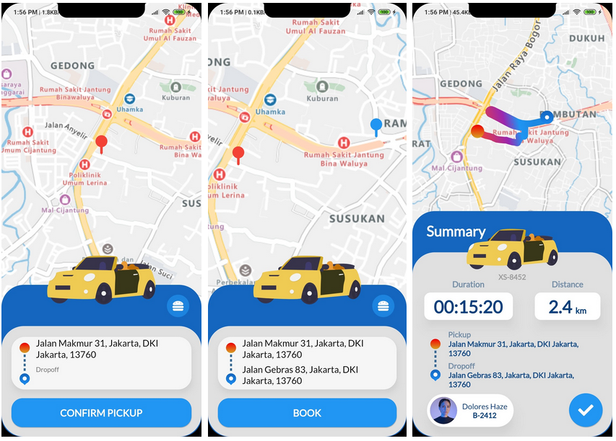
Mobile Application
(1st screen) User selects for pickup point through panning the map
(2nd screen) User selects dropoff point and presses “Book” button
(3rd screen) Trip summary is displayed including duration, distance, pickup and dropoff location
Hakk.AI
Microsoft Azure Virtual Hackathon

Slide 39
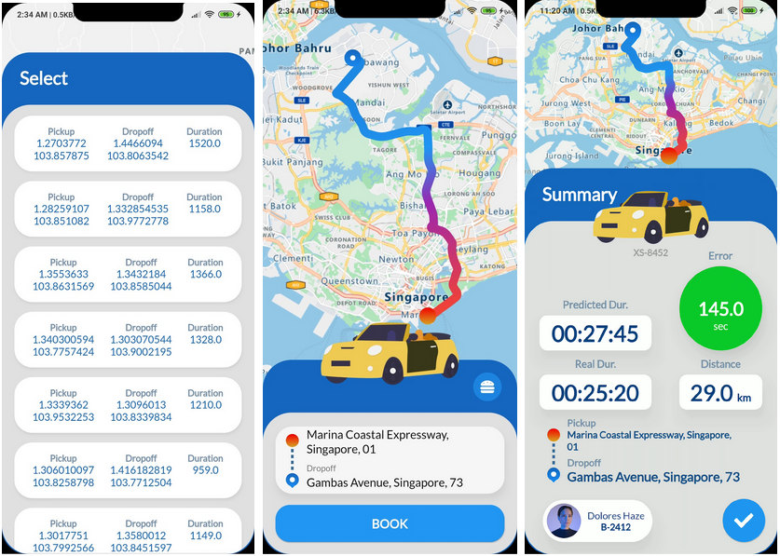
Mobile Application
(1st screen) User selects for data point from test set
(2nd screen) User confirms booking by pressing “Book” button
(3rd screen) Trip summary is displayed including real duration, predicted duration, distance, error, pickup and dropoff location
Hakk.AI
Microsoft Azure Virtual Hackathon

Slide 40
Mobile Application
Our apk can be found here:
https://drive.google.com/drive/folders/1UF0rBrkEAmCcUzdCrpXmEwgs6U-ajuWz?usp=sharing
It is in App Store
https://play.google.com/store/apps/details?id=hakk.ai.grabApp&hl=en%5C
Hakk.AI
Microsoft Azure Virtual Hackathon

Slide 41
Future Work
Hakk.AI
Microsoft Azure Virtual Hackathon

Slide 42
Future Work
Map Matching with Hidden Markov Model:
Can derive estimated distance travel as a feature from the road segment.
We can get the zip code of each road segment and use it to get the point of interest.
After getting the zip code, we could use embedding network and take the dictionary of zip code as input and train the embeddings vectors of the zip code to get the vectors of the most frequently visited neighborhood. Then we use the embedding vector as input by converting input coordinates into zip code before passing getting the vector weights of corresponding zip code.
Integrating with Weather API by mapping it to pingtimestamp to see whether it improves the model.
Getting the actual neighborhood and analyzing the real traffic scenario in Singapore’s context.
Applying multiple stacking in modelling to see how the model could improve.
Completely migrating into production grade Azure Kubernetes service for containerization deployment and management.
Enabling MLOps pipeline for continuous integration and continuous delivery.
Hakk.AI
Microsoft Azure Virtual Hackathon

Slide 43
























Thank You
Hakk.AI
Microsoft Azure Virtual Hackathon

